Slide 1
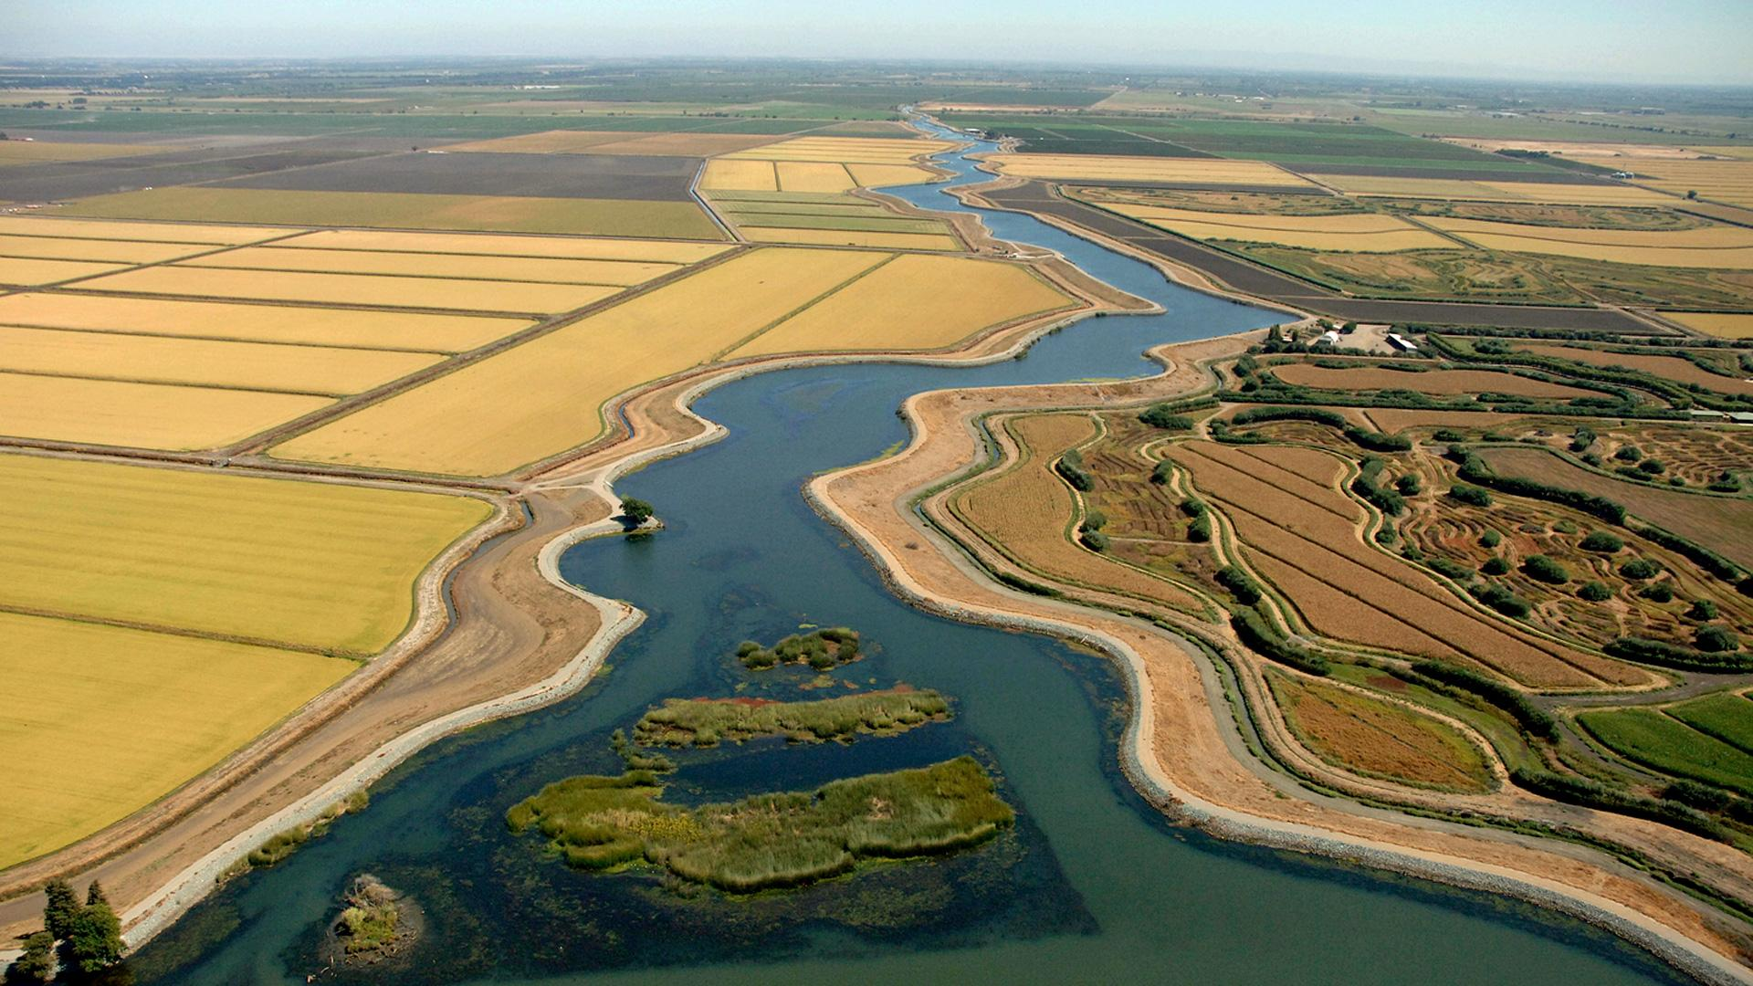
Reorienting to Recovery
Photo Credit: California Department of Water Resources

Slide 2
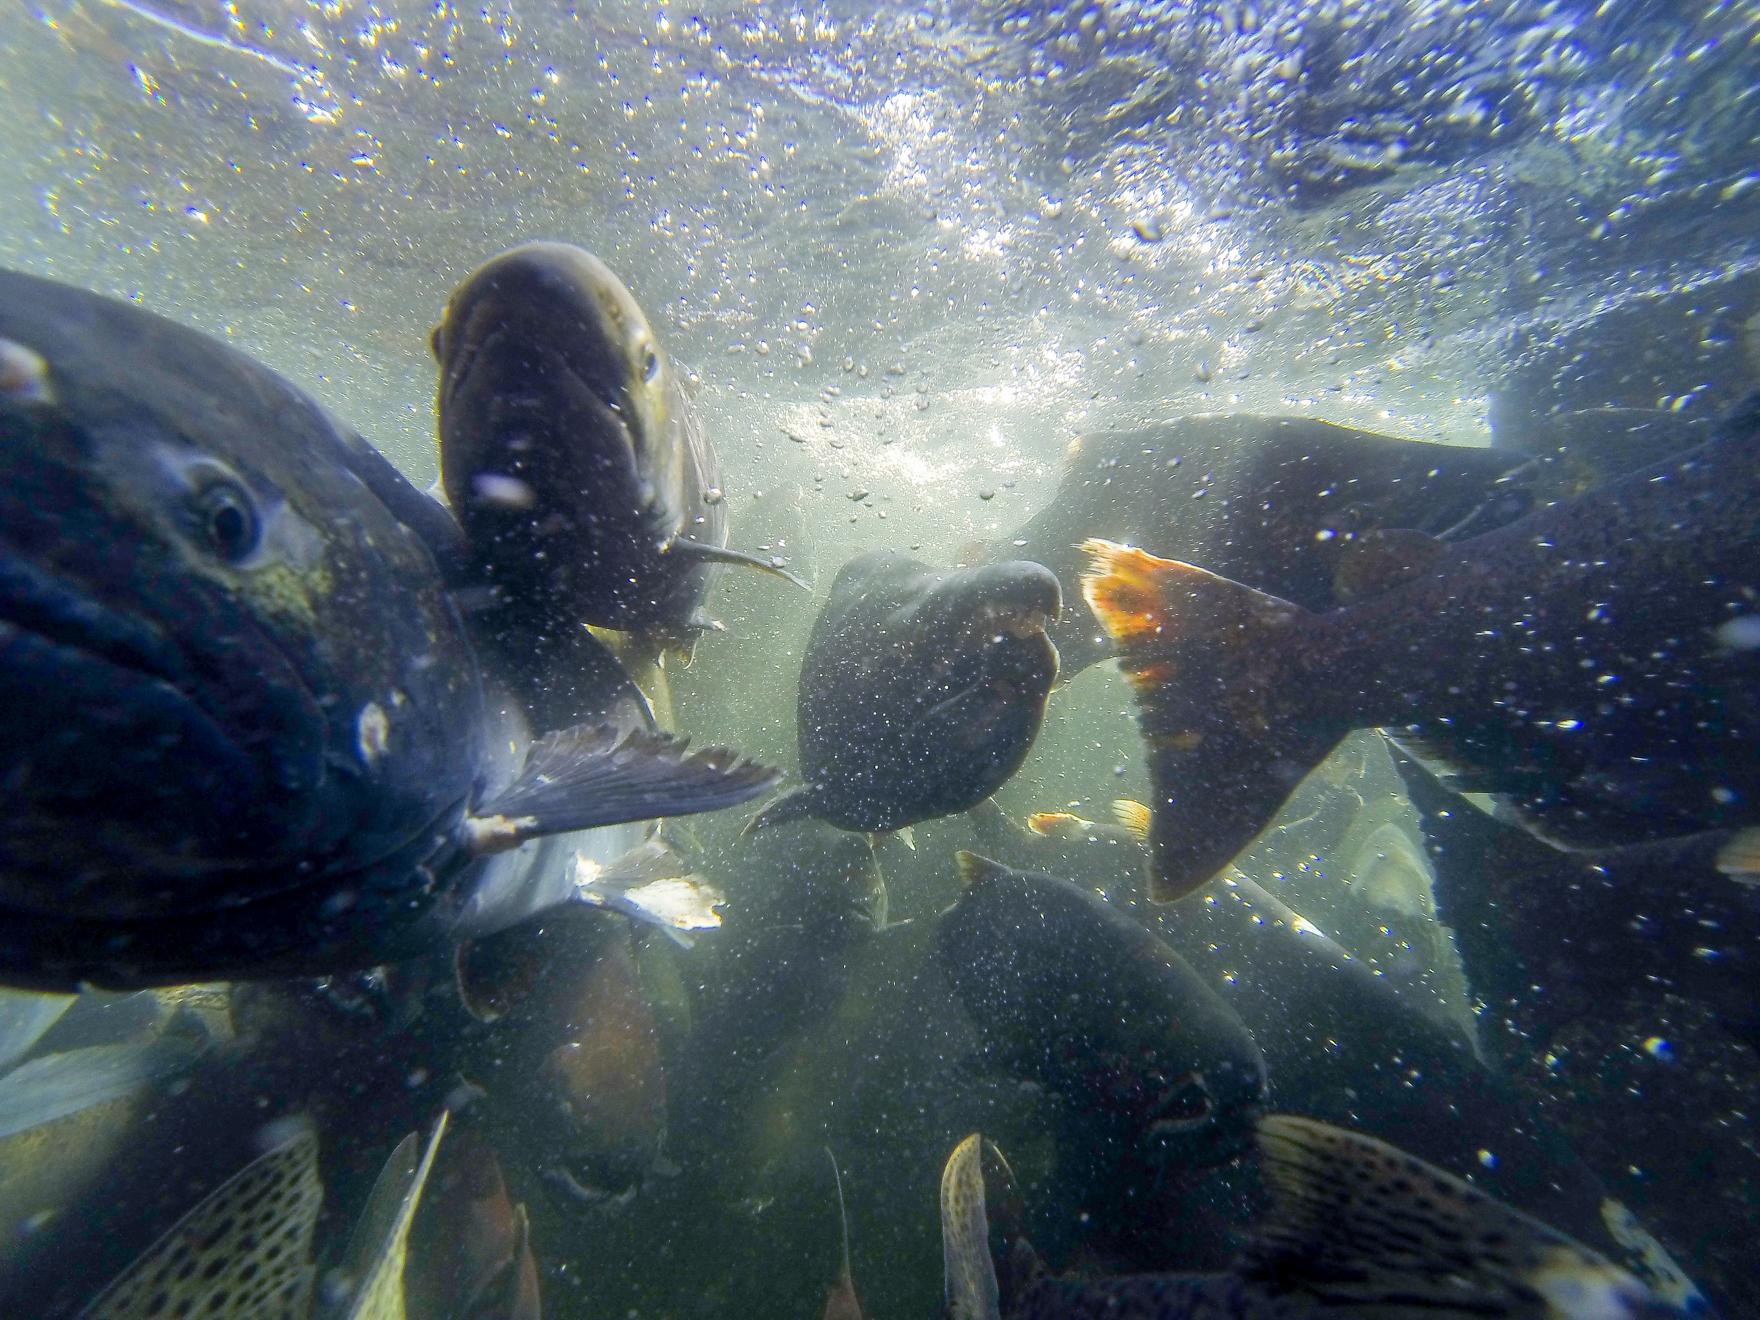



PRESENTATION
GOALS
Provide a project overview
Outline engagement opportunities
Answer questions
Photo Credit: California Department of Water Resources

Slide 3
Collaborative Science and Adaptive Management Process
CSAMP Members
Planning Team Members
Glenn‐Colusa Irrigation District | Thad Bettner
Westlands Water District | Tom Birmingham
The Bay Institute | Gary Bobker
CDFW | Charlton “Chuck” Bonham
Kern County Water Agency | Tom McCarthy
Metropolitan Water District of Southern California | Steve Arakawa
State Water Resources Control Board | Joaquin Esquivel
USBR | Ernest Conant
DWR | Karla Nemeth
Contra Costa Water District | Marguerite Patil
Coalition for a Sustainable Delta | Bill Phillimore
Friant Water Authority | Jason Phillips
U.S. Fish and Wildlife Service | Paul Souza
National Marine Fisheries Service | Cathy Marcinkevage
The Nature Conservancy | Jay Ziegler
Defenders of Wildlife | Rachel Zwillinger
The Bay Institute | Gary Bobker
Metropolitan Water District | Alison Collins
Santa Clara Valley Water District | Frances Brewster
Trout Unlimited | Natalie Stauffer-Olsen
Trout Unlimited | Rene Henery
The “Reorienting to Recovery” project is a CSAMP-sponsored initiative that is being implemented by the project Planning Team through funding provided by the State Water Contractors and a Delta Science Program award.

Slide 4

PROJECT Overview
PHASE
1
Define Salmon Recovery* (Q2 – Q4 2021)
Engage scientists to develop a Salmon Recovery Definition Framework
Engagement** (Q1 2022- Q3 2022)
Solicit input from interested parties throughout the Central Valley (CV)
Decision Support** (Q4 2022 – Q1 2024)
Use participant input to model baseline & benchmark scenarios. Structured Decision Making (SDM) process to select and evaluate scenarios
PHASE
2
PHASE
3
Identify a Suite of Actions to achieve recovery
Goal
*Funded by State Water Contractors
** Funded by Delta Science Program grant award
Notes:
End goal: identify recommended action that have broad support for recovering salmon

Slide 5
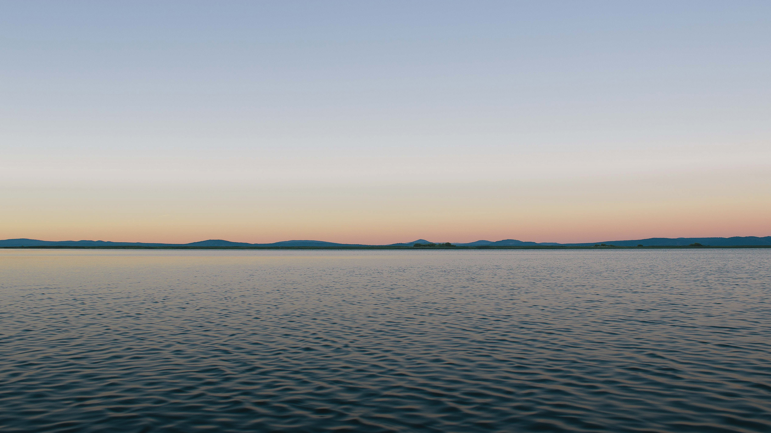


Added
Value
of Project
A structured process to
‘stitch together’ disaggregated
efforts to advance salmonid recovery
Measurable and ambitious recovery targets
Entire salmon life cycle
Multiple models and analytical tools
Consideration of all regional projects
Broad, equitable
and transparent engagement

Slide 6
Recovery Definition
PHASE 1
Notes:
With that I am going to pass it over to rene to cover what we did in phase 1

Slide 7

Participating Scientists
Anchor QEA | John Ferguson
Cramer | Brad Cavallo
CDFW | Brycen Swart
CDFW | Carl Wilcox
DSC | Pascale Goertler
DWR | Brett Harvey
Metropolitan Water District | Alison Collins
NGO | Bruce Herbold
NOAA | Ann Marie Osterback
NOAA | Brian Ellrott
NOAA | Cathy Marcinkevage
NOAA | Kate Spear
NOAA | Rachel Johnson
NOAA | Steve Lindley
PWA | Chuck Hanson
QEDA | Noble Hendrix
SWRCB | Erin Foresman
TNC | Julie Zimmerman
TU | Natalie Stauffer-Olsen
TU | Rene Henery
USBR | Josh Israel
USBR | Mike Beakes
USFWS | Matt Dekar
USFWS | Megan Cook
PHASE 1
Thank you to the following scientists (and organizations) for helping to develop the recovery definition framework over the course of twelve workshops (and subsequent working groups) in 2021

Slide 8





Uses Viable Salmonid Population parameters (abundance, productivity, diversity, spatial structure) as a starting place for objectives
Not tied to regulatory or policy processes
Seeks to go beyond delisting & support long-term harvest
Distinguishes between:
  Natural/hatchery origin
  Runs
  Species
  Listed/non-listed
Recovery Definition Overview
FRAMEWORK
Biological Objective
Species/Runs
Metric
Time/Spatial Scales
Target/Target Approach

Slide 9
Engagement
PHASES 2 & 3

Slide 10
Engagement Overview
PHASE 2
Phase 2 Engagement
20 presentations to regional and interest-based associations across the Central Valley
2 “deep dive” webinars held in March
Soliciting input via Project Catalog and Watershed Data spreadsheets
Orientation to Engaging with CA Tribes (6/1 from 12-12:45pm) – Led by Krystal Moreno, Shingle Springs Rancheria, and Sherri Norris, CA Indian Environmental Alliance; Email Lindsay Tryba (ltryba@kearnswest.com) for Zoom info
Kickoff meeting series (virtual) to share salmon stories, distill and quantify values in order to evaluating recovery actions in Phase 3; Register on website now
Kickoff Meeting #1 | Tue June 7, 9am-1pm
Kickoff Meeting #2 | Wed June 8, 9am-1pm
Kickoff Meeting #3 | Thu June 16, 9am-1pm

Slide 11
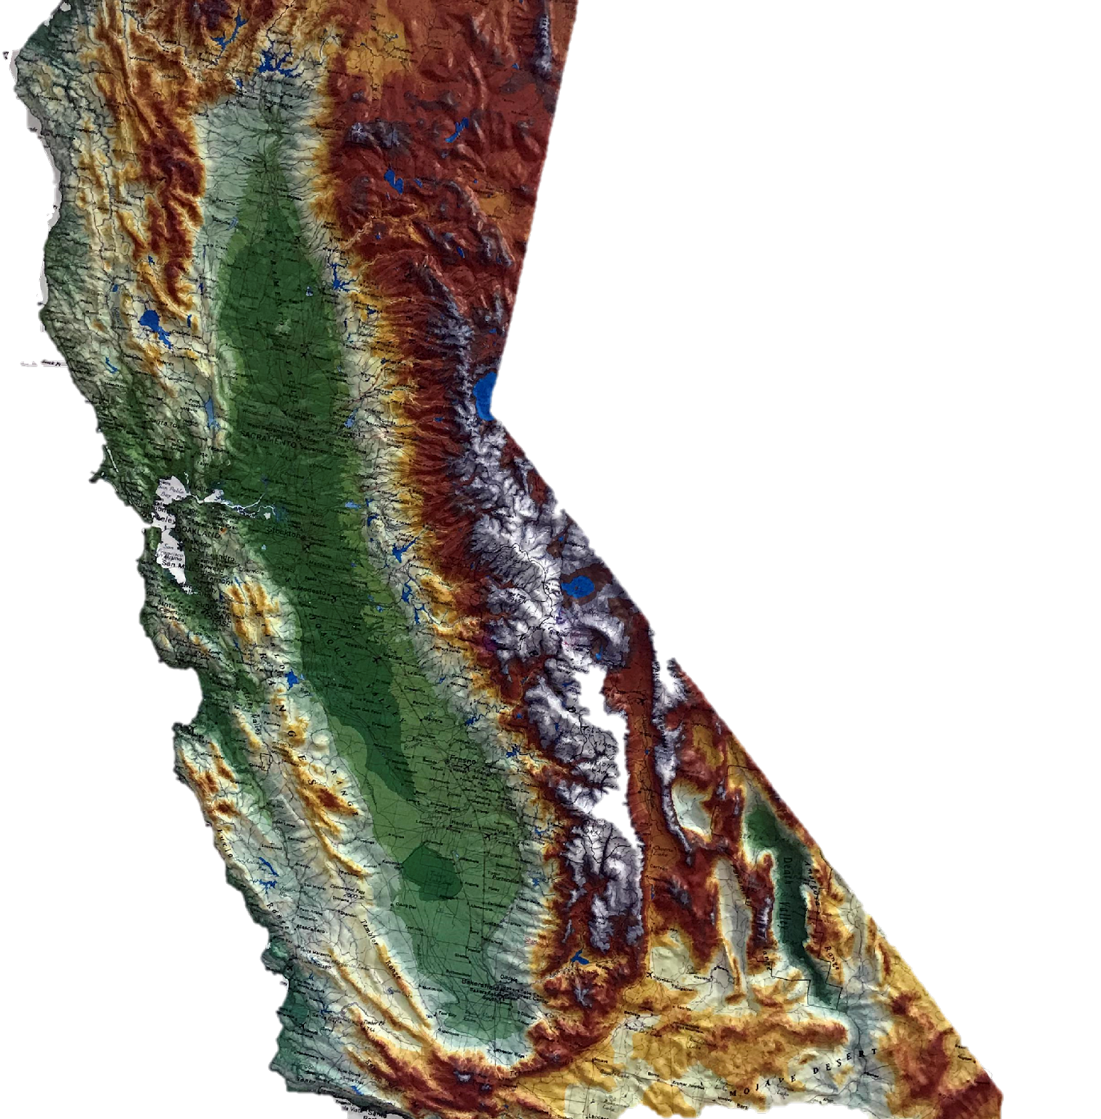
Engagement
PHASE 2
Butte RCD
McCloud River Reintroduction Group
Yuba River Management Team
Tehama RCD
Water Forum
Sacramento River Science Partnership
Cosumnes Coalition
Central Valley Salmon Habitat Partnership
Mokelumne River TAC
Central Valley Joint Venture
Stanislaus River Fish Group
Collaborative Science & Adaptive Management Program
Turlock Irrigation District (Tuolumne interested parties)
Delta Conservancy
San Joaquin Conservancy
Nor-Cal Guides & Sportsmen’s Association
Northern California Water Association
San Joaquin River Restoration Program
Pacific Fishery Management Council
Presentation delivered
Presentation scheduled

Slide 12

Input Request Recap
PHASE 2
Values
  Perspective on values related to salmon recovery
Watershed Specific Data
  Alternatives/modifications to datasets currently being used for modeling
  Information to set targets at the specific watershed level
Project Catalog
  Current and planned projects

Slide 13
Engagement Preview
PHASE 3
Science Team (Phase 1 Workshop participants + watershed scientists)
  Provide technical advice on Recovery definition details/modifications, modeling and assessment of scenarios as needed
Forum (Interested parties)
  Provide Phase 2 input & stay informed/provide feedback via Phase 3 workshops
Working Group (A representative subset of the Forum)
  Provide input in the development and refinement of different recovery scenarios as part of the SDM process

Slide 14
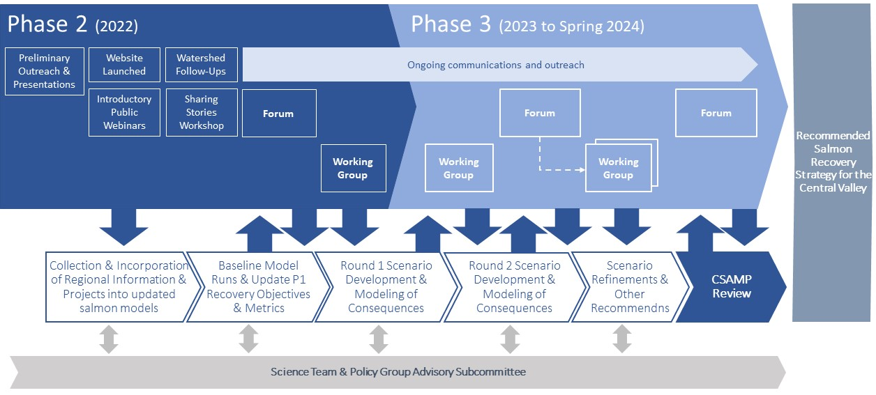
Process Roadmap

Slide 15
Stakeholder Engagement Recap
Register for virtual kickoff meeting series
Provide input on Project Catalog & Watershed Data
Contact Lindsay Tryba (ltryba@kearnswest.com)
Stay informed: https://csamp.baydeltalive.com/recovery/reorienting-to-recovery
Kickoff Meeting #1 | Tue June 7, 9am-1pm
Kickoff Meeting #2 | Wed June 8, 9am-1pm
Kickoff Meeting #3 | Thu June 16, 9am-1pm

Slide 16
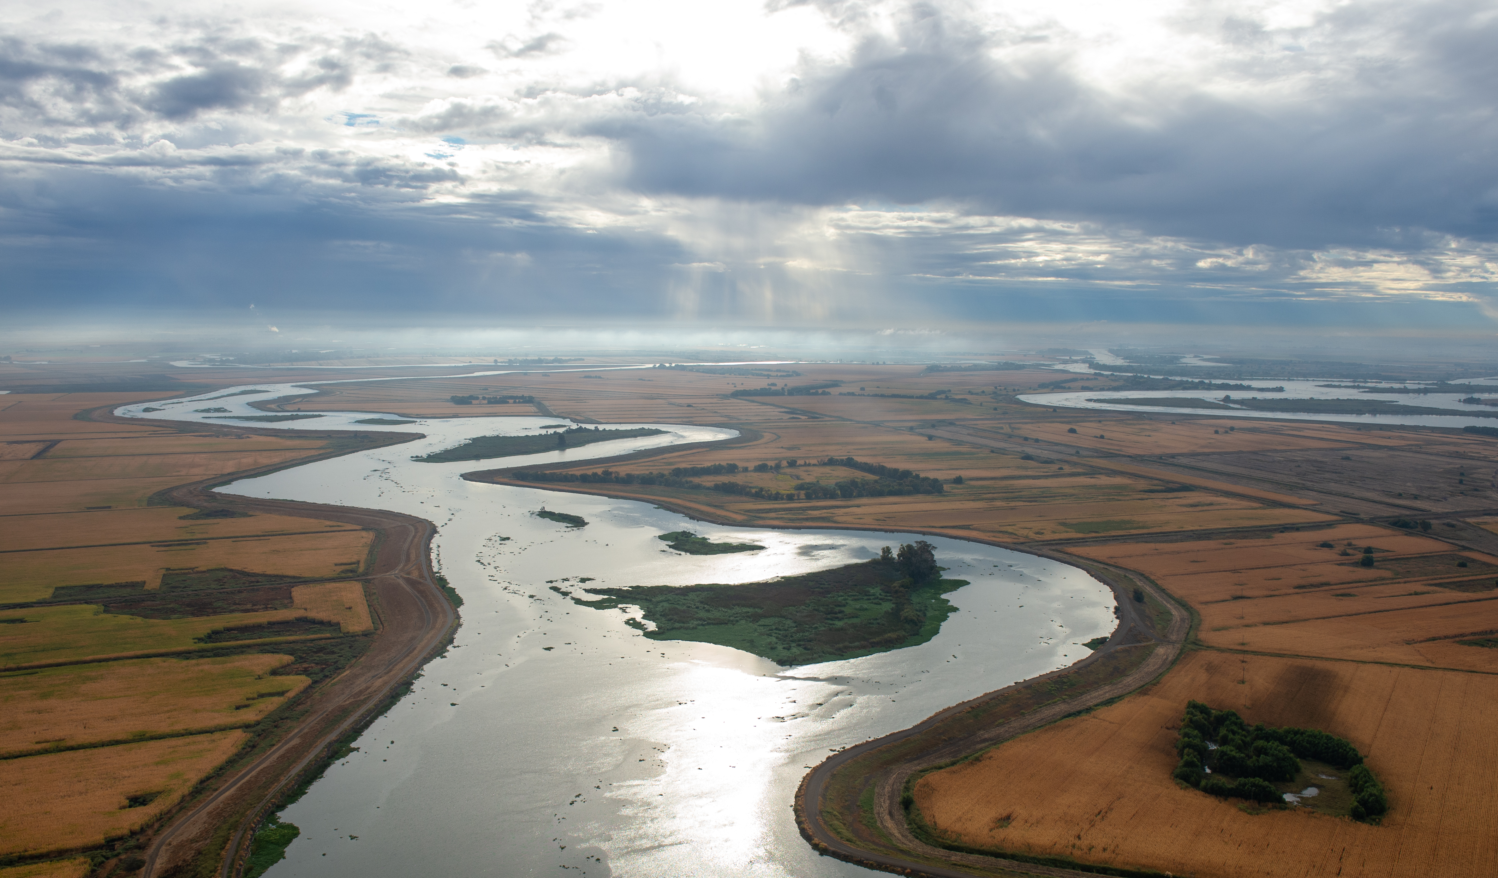
Questions?
Photo Credit: California Department of Water Resources

